Slide 1
REINFORCEMENT
LEARNING
Dr. T.Adilakshmi
Professor & HOD
Department of CSE, VCE

Slide 2
REINFORCEMENT LEARNING
Reinforcement learning addresses the question of how an autonomous agent that senses and acts in its environment can learn to choose optimal actions to achieve its goals.
This problem covers tasks such as learning to control a mobile robot, learning to optimize operations in factories, and learning to play board games.
Each time the agent performs an action in its environment, a trainer may provide a reward or penalty to indicate the desirability of the resulting state
The task of the agent is to learn from this indirect, delayed reward, to choose sequences of actions that produce the greatest cumulative reward.

Slide 3
INTRODUCTION
The robot, or agent, has a set of sensors to observe the state of its environment, and a set of actions it can perform to alter this state.
A mobile robot may have sensors such as a camera and sonars, and actions such as "move forward" and "turn.“
Its task is to learn a control strategy, or policy, for choosing actions that achieve its goals.
The robot may have a goal of docking onto its battery charger whenever its battery level is low
The goals of the agent can be defined by a reward function that assigns a numerical value-an immediate payoff-to each distinct action the agent may take from each distinct state.

Slide 4
For example, the goal of docking to the battery charger can be captured by assigning a positive reward (e.g., +100) to state-action transitions that immediately result in a connection to the charger and a reward of zero to every other state-action transition.
This reward function may be built into the robot or known only to an external teacher who provides the reward value for each action performed by the robot.
The task of the robot is to perform sequences of actions, observe their consequences, and learn a control policy.
The control policy we desire is one that, from any initial state, chooses actions that maximize the reward accumulated over time by the agent.

Slide 5
This general setting for robot learning is in Figure 13.1.
The agent exists in an environment described by some set of possible states S.
It can perform any of a set of possible actions A. Each time it performs an action ai, in some state st the agent receives a real-valued reward ri, that indicates the immediate value of this state-action transition.
This produces a sequence of states si, actions ai, and immediate rewards ri
The agent's task is to learn a control policy, π : S -> A, that maximizes the expected sum of these rewards, with future rewards discounted exponentially by their delay

Slide 6
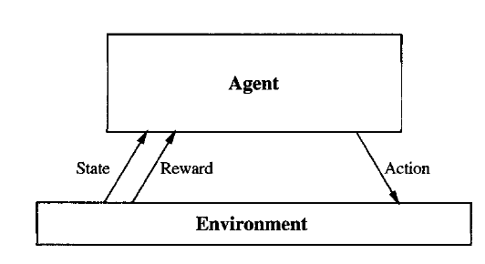


An agent interacting with its environment
.

Slide 7
Reinforcement learning problem differs from other function approximation tasks in several important respects.
Delayed reward
Exploration
Partially observable states
Life-long learning

Slide 8
Delayed reward
The task of the agent is to learn a target function π that maps from the current state s to the optimal action a = π(s).
In earlier chapters we have assumed that when learning some target function such as π, each training example would be a pair of the form (s, π(s))
In reinforcement learning, however, training information is not available in this form. Instead, the trainer provides only a sequence of immediate reward values as the agent executes its sequence of actions.

Slide 9
Exploration
The learner faces a tradeoff in choosing whether to favor exploration of unknown states and actions or exploitation of states and actions that it has already learned will yield high reward (to maximize its cumulative reward).

Slide 10
Partially observable states.
in many practical situations sensors provide only partial information.
For example, a robot with a forward-pointing camera cannot see what is behind it. In such cases, it may be necessary for the agent to consider its previous observations together with its current sensor data when choosing actions, and the best policy may be one that chooses actions specifically to improve the observability of the environment.

Slide 11
Life-long learning
For example, a mobile robot may need to learn how to dock on its battery charger, how to navigate through narrow corridors, and how to pick up output from laser printers.
This setting raises the possibility of using previously obtained experience or knowledge to reduce sample complexity when learning new tasks

Slide 12
THE LEARNING TASK
We formulate the problem of learning sequential control strategies
assume that the agent can predict the next state that will result from each action
The agent is trained by an expert who shows it examples of optimal action sequences, or that it must train itself by performing actions of its own choice

Slide 13
Markov decision processes
In a Markov decision process (MDP) the agent can perceive a set S of distinct states of its environment and has a set A of actions that it can perform.
At each discrete time step t, the agent senses the current state st, chooses a current action at and performs it.
The environment responds by giving the agent a reward
rt =r (st, at) and by producing the succeeding state
st+l = δ(st, at)
the functions δ and r are part of the environment and are not necessarily known to the agent.
In an MDP, the functions δ(st, a,) and r (st, at)depend only on the current state and action, and not on earlier states or actions

Slide 14
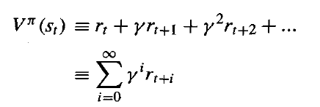
The task of the agent is to learn a policy, π : S -> A, for selecting its next action at, based on the current observed state st; that is, π(st) = at.
which policy π we would like the agent to learn? One obvious approach is to require the policy that produces the greatest possible cumulative reward for the robot over time.
Define the cumulative value V^{π}(st) achieved by following an arbitrary policy π from an arbitrary initial state st as follows
13.1
where the sequence of rewards rt+i is generated by beginning at state s_{t} and by repeatedly using the policy π to select actions.
0<ɣ ≤ 1 is a constant that determines the relative value of delayed versus immediate rewards

Slide 15
In particular, rewards received i time steps into the future are discounted exponentially by a factor of ɣ^{i} .
Note if we set ɣ = 0, only the immediate reward is considered. As we set ɣ closer to 1, future rewards are given greater emphasis relative to the immediate reward.
The quantity V^{π}(s) defined by Equation (13.1) is often called the discounted cumulative reward achieved by policy π from initial state s.

Slide 16

Agent learn a policy π that maximizes V^{π}(s) for all states s. We call such a policy an optimal policy and denoted by π*
function v^{π*}(s) of such an optimal policy is called as V*(s), the discounted cumulative reward obtained by following the optimal policy beginning at state s.

Slide 17
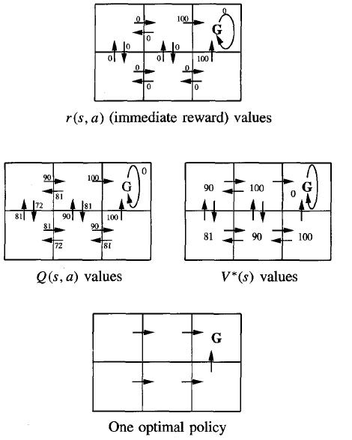
Figure 13.2: A simple deterministic world to illustrate the basic concepts of Q-learning.

Slide 18
Each grid square represents a distinct state,
Each arrow a distinct action.
The immediate reward function, r(s, a) gives reward 100 for actions entering the goal state G, and zero otherwise.
Values of V*(s) and Q(s, a) follow from r(s, a),
discount factor y = 0.9.
An optimal policy, corresponding to actions with maximal Q values, is also shown.

Slide 19
The six grid squares represent six possible states, or locations, for the agent. Each arrow represents a possible action the agent can take to move from one state to another.
The number associated with each arrow represents the immediate reward r(s, a) the agent receives if it executes the corresponding state-action transition.
The immediate reward in this particular environment is defined to be zero for all state-action transitions except for those leading into the state labeled G.
It is convenient to think of the state G as the goal state, because the only way the agent can receive reward, in this case, is by entering this state.
in this particular environment, the only action available to the agent once it enters the state G is to remain in this state. For this reason, G is called an absorbing state.

Slide 20
Once the states, actions, and immediate rewards are defined, and once we choose a value for the discount factor γ, we can determine the optimal policy π* and its value function V*(s).
In this case, let us choose γ = 0.9. The diagram at the bottom of the figure shows one optimal policy for this setting .

Slide 21
The diagram at the right of Figure 13.2 shows the values of V* for each state.
For example, consider the bottom right state in this diagram. The value of V* for this state is 100 because the optimal policy in this state selects the "move up" action that receives immediate reward 100. Thereafter, the agent will remain in the absorbing state and receive no further rewards.
Similarly, the value of V* for the bottom center state is 90. This is because the optimal policy will move the agent from this state to the right (generating an immediate reward of zero), then upward (generating an immediate reward of 100). Thus, the discounted future reward from the bottom center state is
0+y100+y²0+Y³0+...=90

Slide 22
Q LEARNING
It is difficult to learn the function π * : S -> A directly, because the available training data does not provide training examples of the form (s, a).
the only training information available to the learner is the sequence of immediate rewards r(si, ai) for i = 0, 1,2, . . . .
given this kind of training information it is easier to learn a numerical evaluation function defined over states and actions, then implement the optimal policy in terms of this evaluation function.

Slide 23
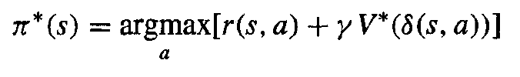
The agent should attempt to learn evaluation function V*.
The agent should prefer state sl over state s2 whenever V*(sl) > V*(s2), because the cumulative future reward will be greater from s1.
The optimal action in state s is the action a that maximizes the sum of the immediate reward r(s, a) plus the value V* of the immediate successor state, discounted by y.
----- (13.3)
δ(s, a) denotes the state resulting from applying action a to state s

Slide 24
the agent can acquire the optimal policy by learning V*, provided it has perfect knowledge of the immediate reward function r and the state transition function δ.
When the agent knows the functions r and δ used by the environment to respond to its actions, it can then use Equation (13.3) to calculate the optimal action for any state s
Unfortunately, learning V* is a useful way to learn the optimal policy only when the agent has perfect knowledge of δ and r. This requires that it be able to perfectly predict the immediate reward and immediate successor for every possible state-action transition.

Slide 25
In cases where either δ or r is unknown, learning V* is unfortunately of no use for selecting optimal actions because the agent cannot evaluate Equation (13.3).

Slide 26

The Q Function
Let us define the evaluation function Q(s, a) so that its value is the maximum discounted cumulative reward that can be achieved starting from state s and applying action a as the first action
the value of Q is the reward received immediately upon executing action a from state s, plus the value (discounted by y) of following the optimal policy thereafter.
----13.4
Q(s, a) is exactly the quantity that is maximized in Equation (13.3)
in order to choose the optimal action a in state s.
Rewrite Equation (13.3) in terms of Q(s, a) as
----13.5

Slide 27
it shows that if the agent learns the Q function instead of the V* function, it will be able to select optimal actions even when it has no knowledge of the functions r and δ.
it need only consider each available action a in its current state s and choose the action that maximizes Q(s, a)
The agent can choose the optimal action without ever conducting a lookahead search to explicitly consider what state results from the action.

Slide 28
Q value for each state-action transition equals the r value for this transition plus the V* value for the resulting state discounted by γ.
The optimal policy shown in the figure13.2 corresponds to selecting actions with maximal Q values.

Slide 29


Algorithm for Learning Q
Learning the Q function corresponds to learning the optimal policy
The key problem is finding a reliable way to estimate training values for Q, given only a sequence of immediate rewards r spread out over time. This can be accomplished through iterative approximation.
Relationship between Q and V*
Which allows rewriting equation 13.4 as
13.6

Slide 30

This recursive definition of Q provides the basis for algorithms that iteratively approximate Q
symbol refer to the learner's estimate, of the actual Q function
In this algorithm the learner represents its hypothesis
by a large table with a separate entry for each state-action pair. The table entry for the pair (s, a) stores the value
for (s,a) - the, learner's current hypothesis about the actual but unknown value Q(s, a).
The table can be initially filled with zeros.
The agent repeatedly observes its current state s, chooses some action a, executes this action, then observes the resulting reward r = r(s, a) and the new state s' = δ(s, a).

Slide 31

It then updates the table entry for (s,a) following each such transition, according to the rule:
this training rule uses the agent's current values for the new state s' to refine its estimate of (s,a), for the previous state s.
----- (13.7)

Slide 32
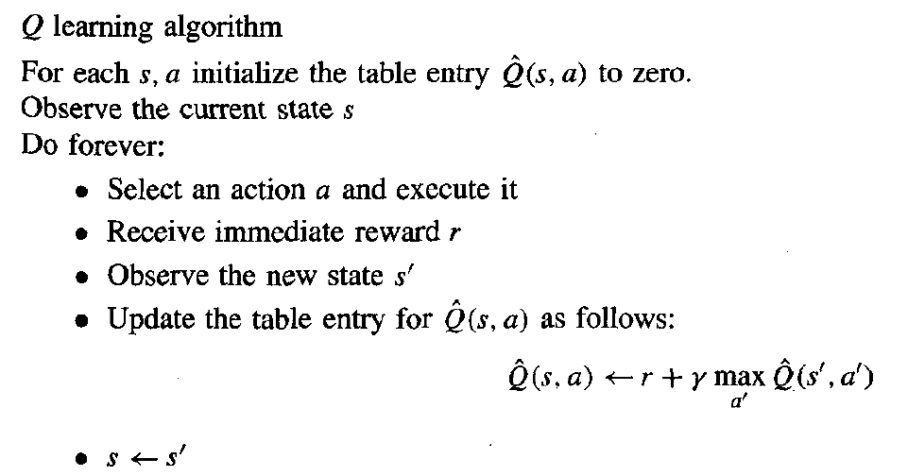

Slide 33
Using this algorithm the agent's estimate converges in the limit to the actual Q function, the reward function r is bounded, and actions are chosen so that every state-action pair is visited infinitely often

Slide 34
An Illustrative Example
To illustrate the operation of the Q learning algorithm, consider a single action taken by an agent, and the corresponding refinement to
In this example, the agent moves one cell to the right in its grid world and receives an immediate reward of zero for this transition. It then applies the training rule of Equation (13.7) to refine its estimate for the state-action transition it just executed.
According to the training rule, the new estimate for this transition is the sum of the received reward (zero) and the highest value associated with the resulting state (1oo), discounted by y (.9).

Slide 35
Consider applying this algorithm to the grid world and reward function shown in Figure 13.2, for which the reward is zero everywhere, except when entering the goal state.
Since this world contains an absorbing goal state, we will assume that training consists of a series of episodes.
During each episode, the agent begins at some randomly chosen state and is allowed to execute actions until it reaches the absorbing goal state.
When it does, the episode ends and the agent is transported to a new, randomly chosen, initial state for the next episode

Slide 36
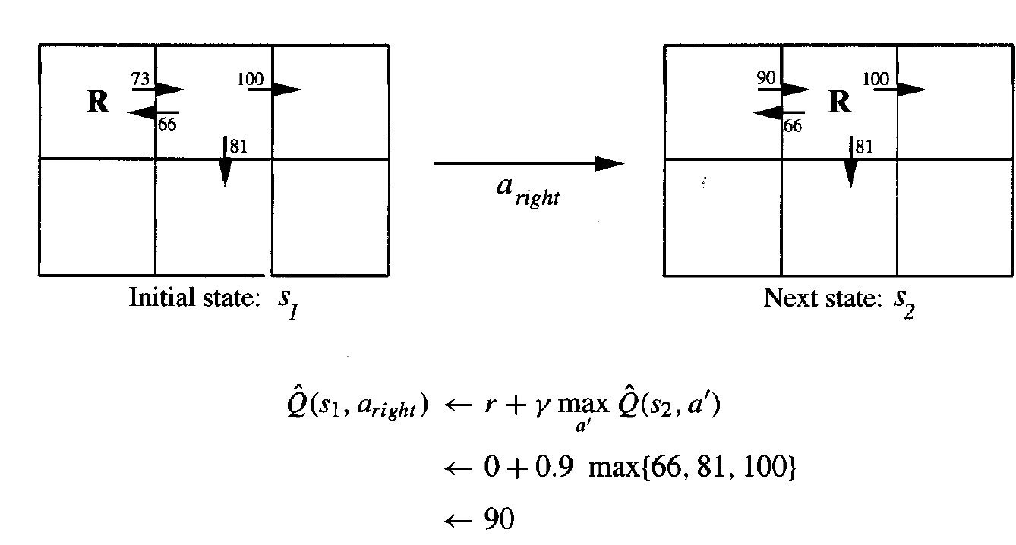

Slide 37
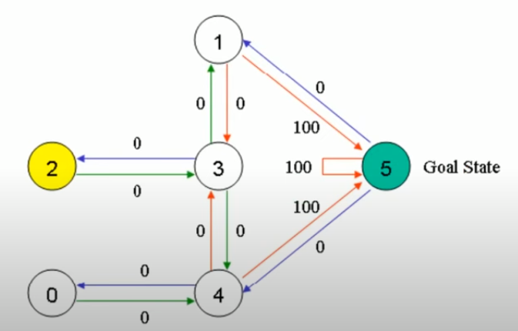
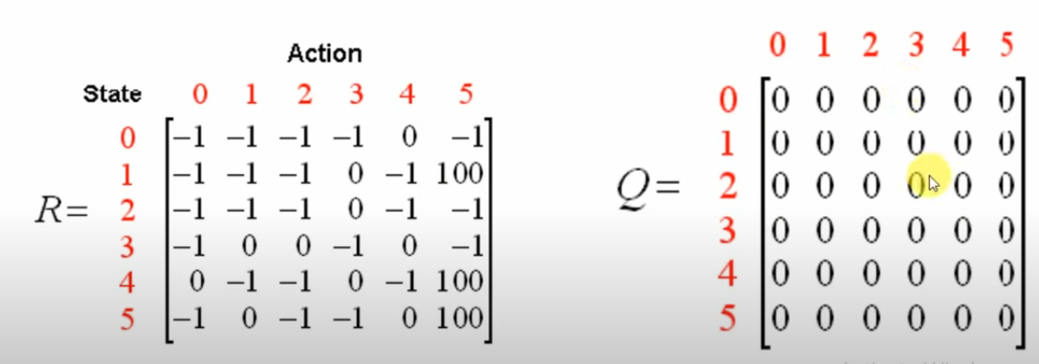
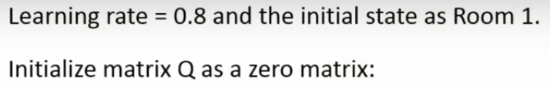

Slide 38
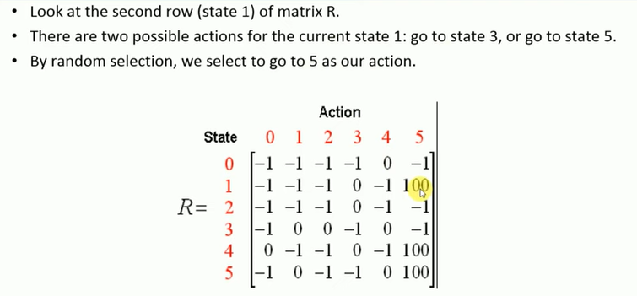

Slide 39
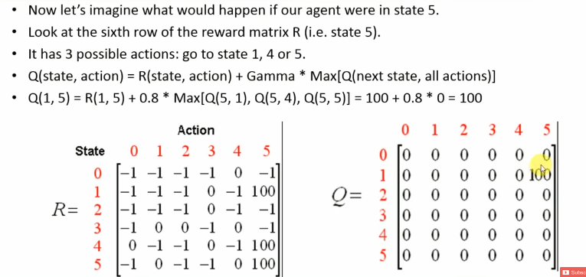


Slide 40
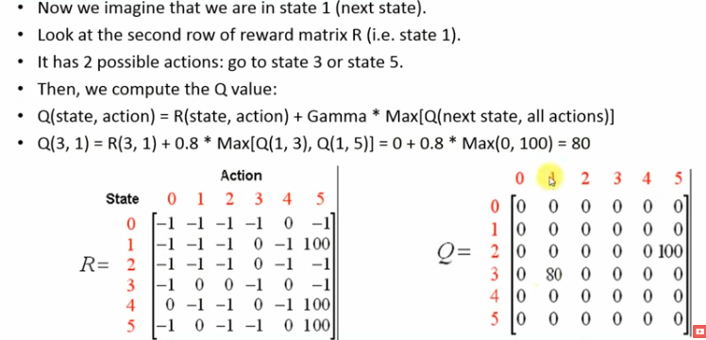

Slide 41
